Slide 1

Analysis of Uber and Lyft Bookings in Boston
Athul Sony
Karthik Chevuru

Slide 2
About the dataset
Contains data regarding various types of Uber & Lyft cab bookings in Boston for 2018
Source and Destination
Distance
Price per booking
the date of the ride
the weather when the booking was made
Applicable Surge Multiplier
Objective
Analyze the distribution of prices for Uber and Lyft per cab category
Analyze when the surge happens. Do Mondays have more demand than Sundays?
Analyze the dependency of weather on surge pricing and demand
Which time of the day maximum number of bookings happen?
Most sought after ride network by Northeastern Students
Distribution of distance for cab type
Market Share of uber and Lyft

Slide 3
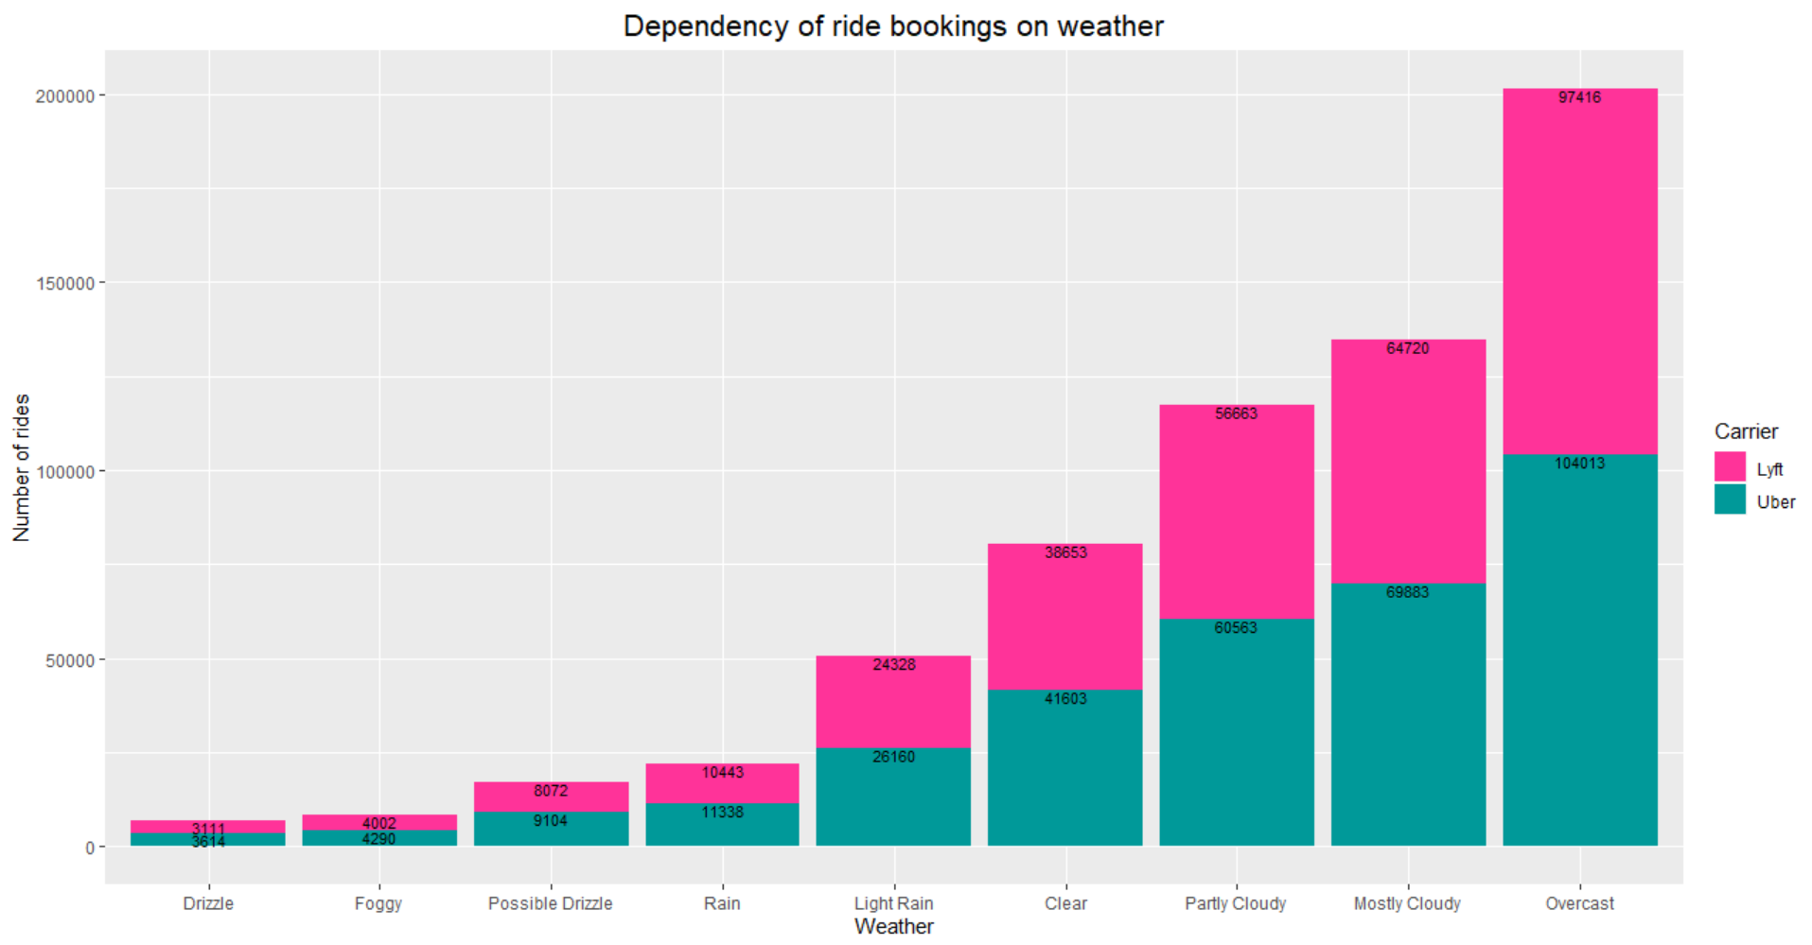
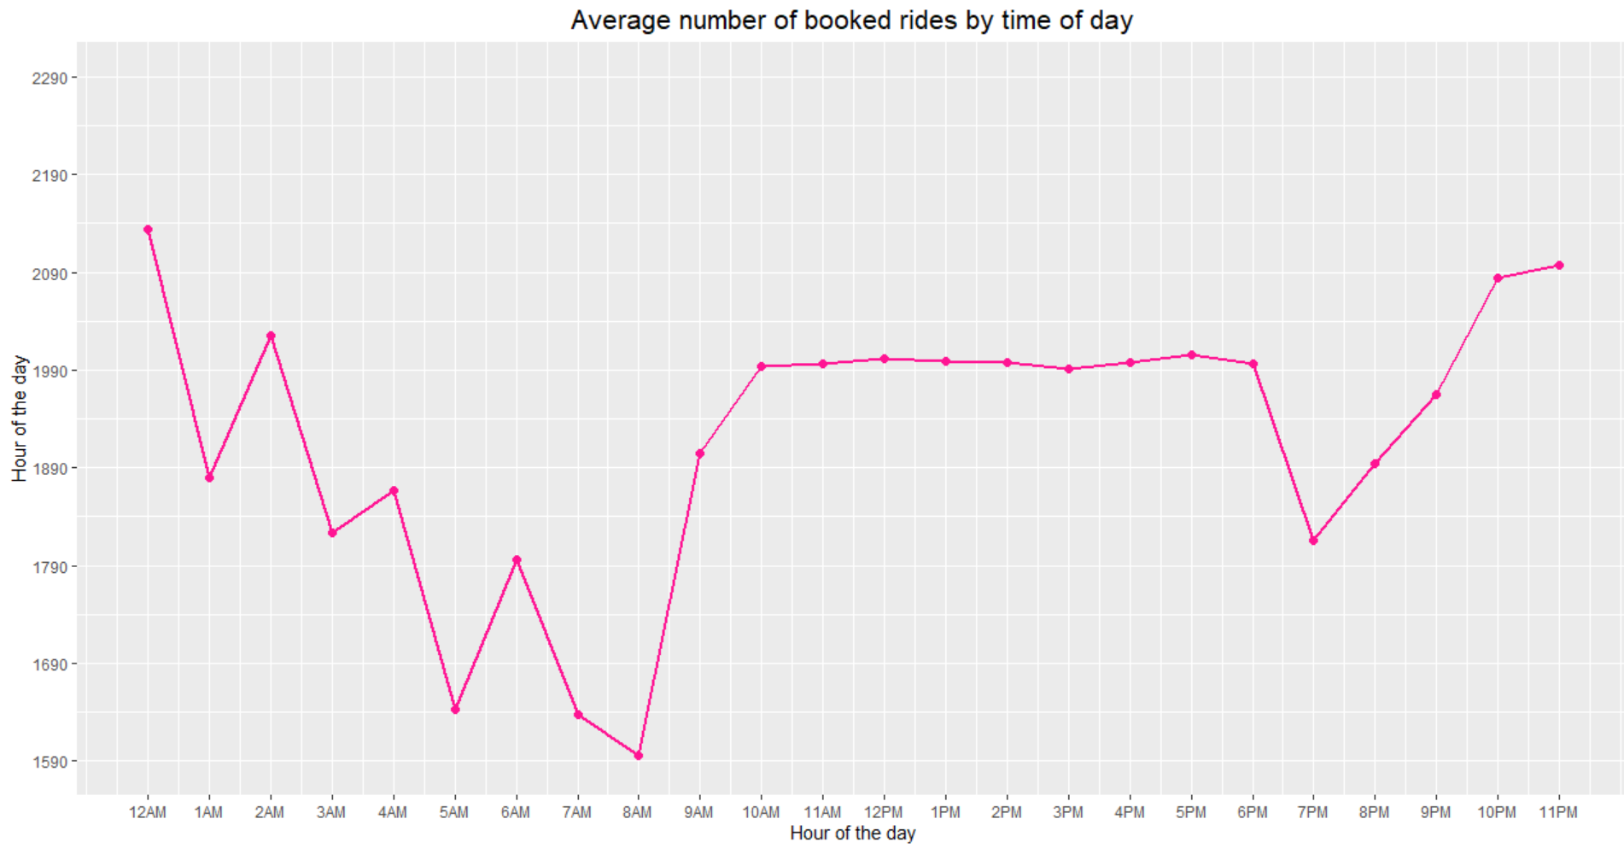
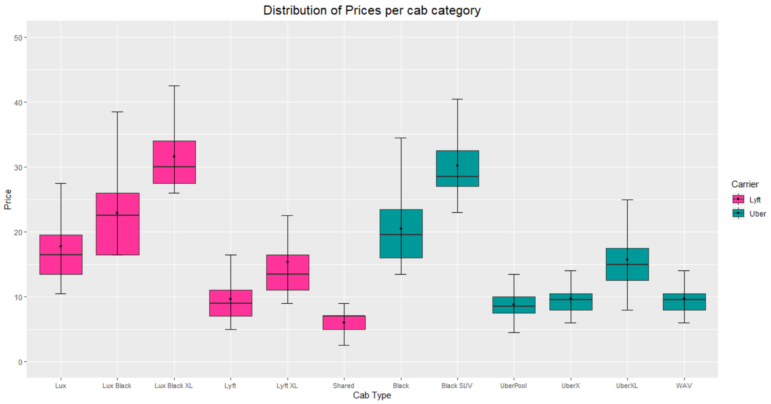
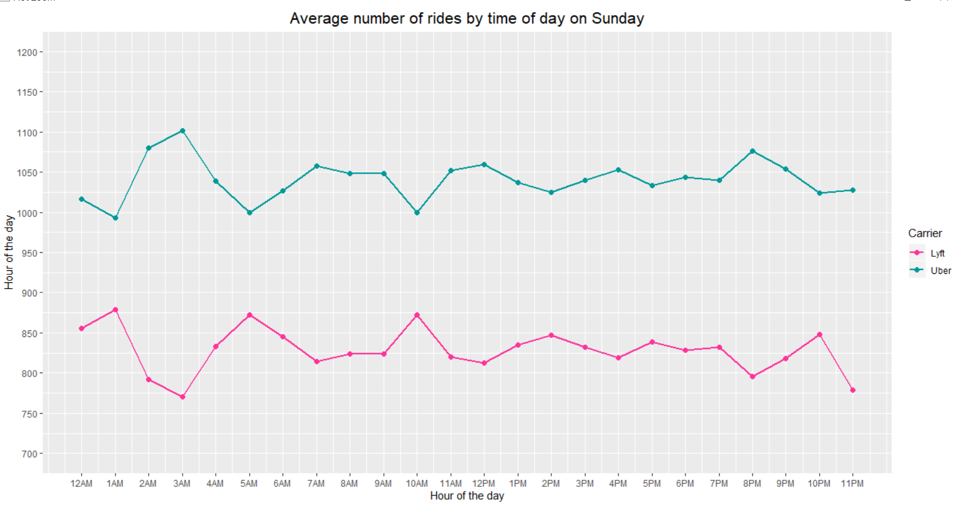

Slide 4
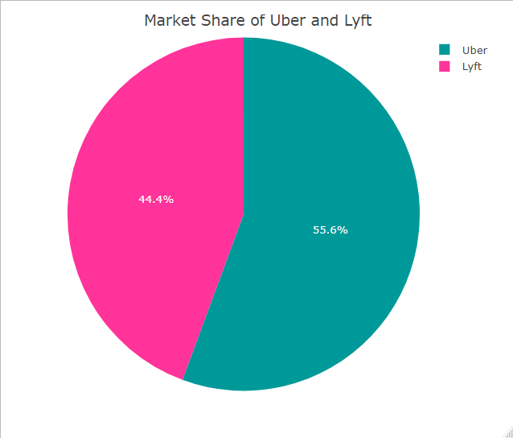
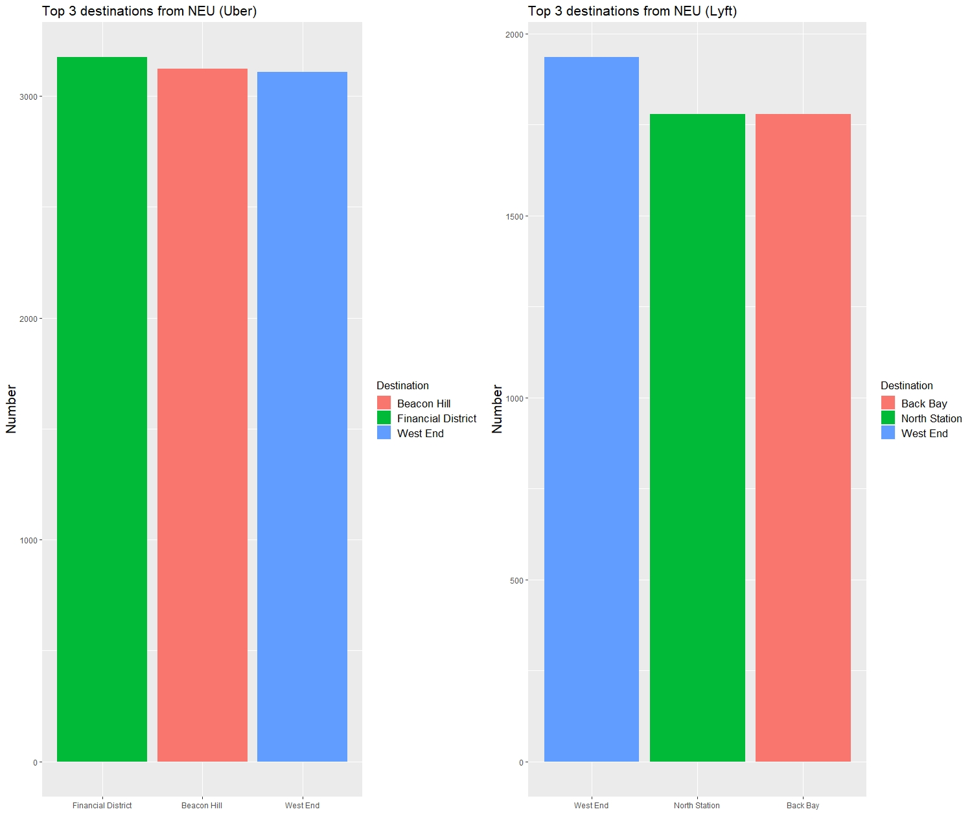
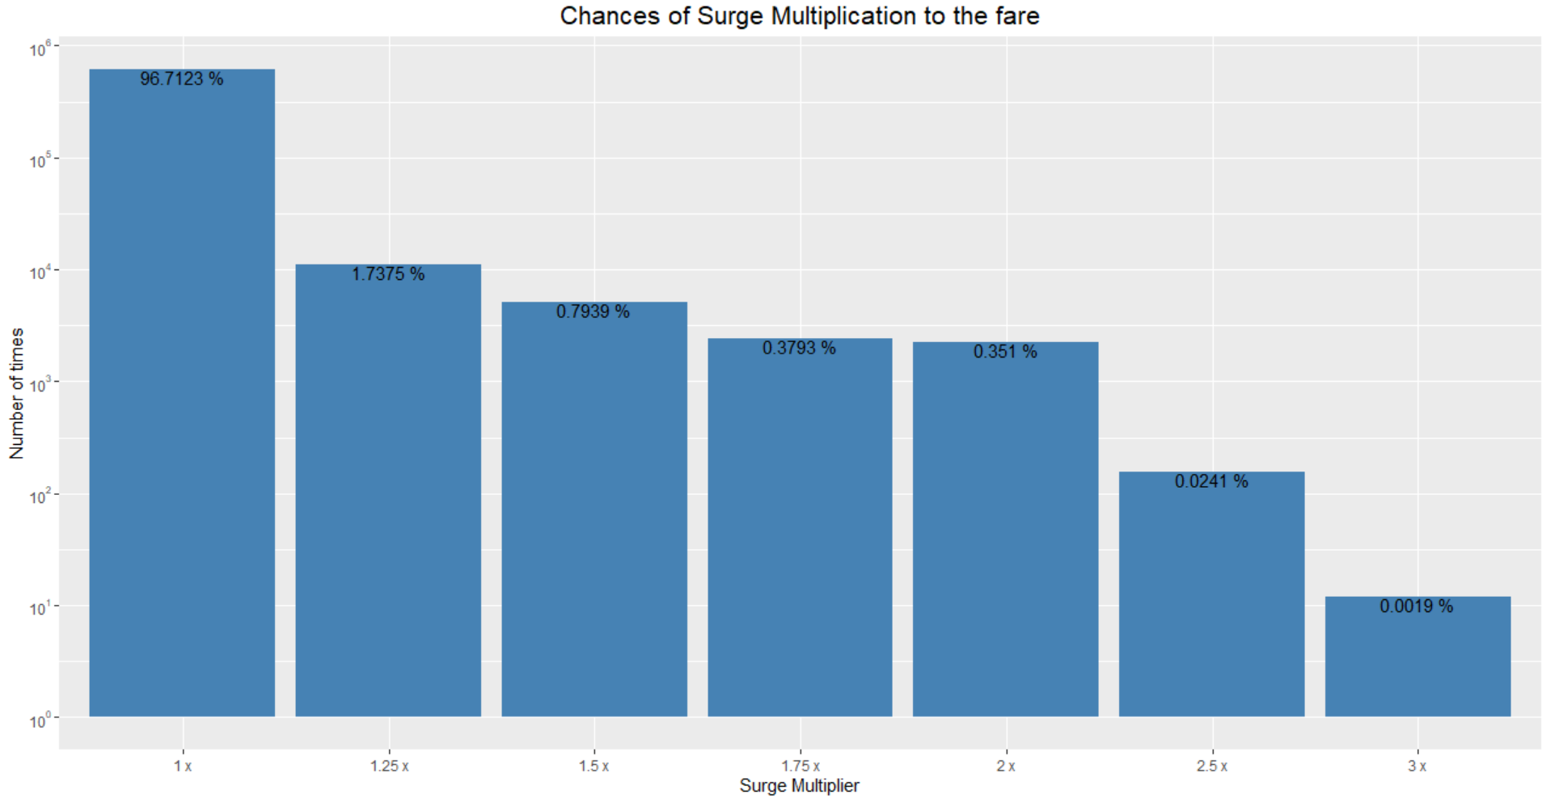

Slide 5
Challenges faced
Cleaning up dates and time
Cleaning up latitude and longitude positions
Replacing dummy product ID’s with the correct Product ID’s
Maintaining a uniform unit of distance throughout for calculations

